Slide 1
Unit 16
WHERE’S THE POST OFFICE?
Lesson 3

Slide 2
1. Listen and repeat.
1. | Where's the post office? ↷ It's opposite the stadium. ↷
2. | Where's the cinema? ↷ It's next to the post office. ↷
3. | Where's the supermarket? ↷ It's on the corner of the street. ↷

Slide 3
2. Listen and circle a or b.
a. It's opposite the museum.
b. It's opposite the library.
1. Where's the cinema?
a. It's next to the supermarket.
b. It's next to the stadium.
2. Where's the restaurant?
a. It's on the corner of the street.
b. It's at the end of the street.
3. Where's the park?

Slide 4
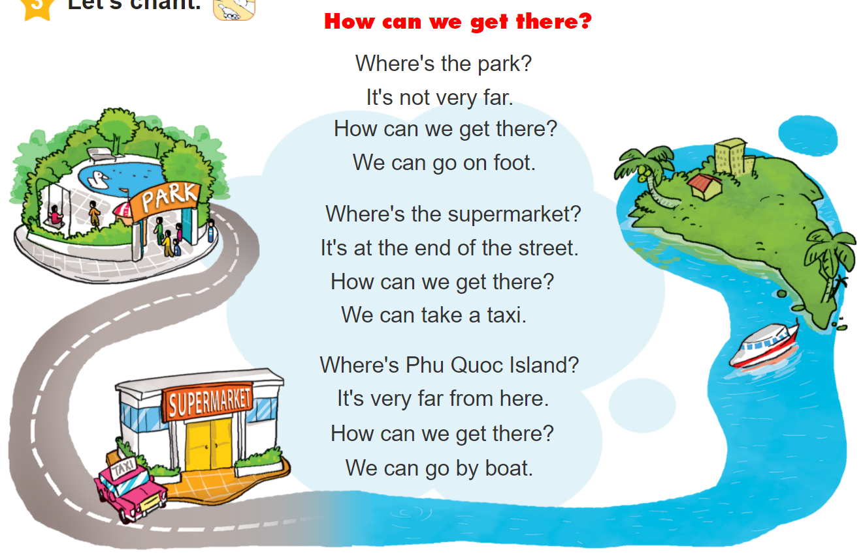
3. Let’s chant.

Slide 5
Vocabulary
Get off
: Xuống
Stop
: Điểm dừng
On the left/right
: ở bên trái/phải
fence
: Hàng rào

Slide 6
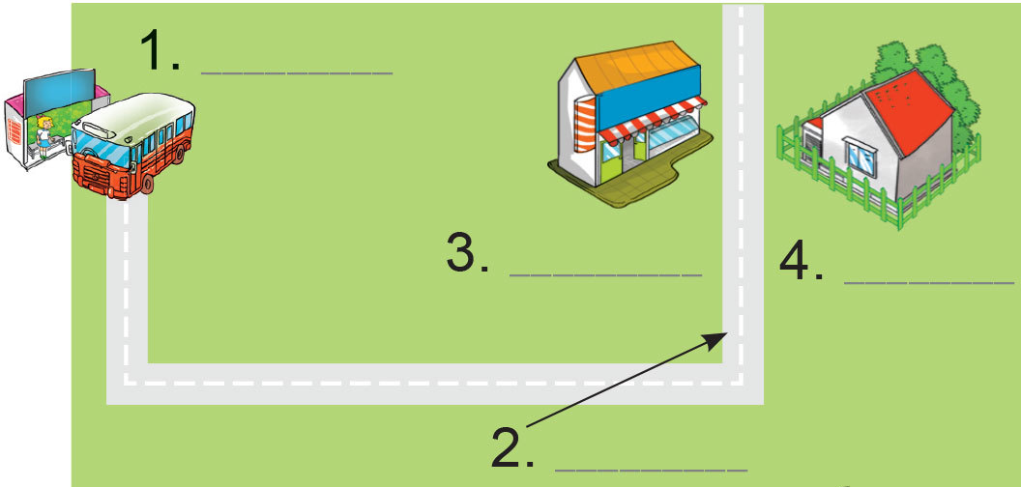
4.1. Label the places.
Dear Linda,
I'm happy you're going to visit me. You can take bus Number 12 at West Street and get off at the fifth stop. Then walk along the street for five minutes. You will see Pear Street at the end of the street. Turn left and you will see a pharmacy on the left. My house is opposite the pharmacy. It is behind a green fence.
See you!
Tony
1. _____________
2. _____________
3. _____________
4. _____________
bus stop
Pear Street
pharmacy
Tony's house

Slide 7
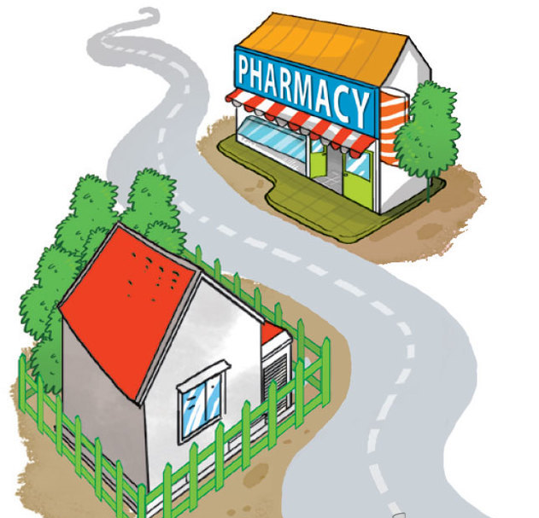
4.2. Answer the questions.
1. What bus should Linda take?
She should take bus Number 12.
2. Where should she get off the bus?
She should get off at the fifth stop.
3. What's the name of the road at the end of the street?
It's Pear Street.
4. What's opposite Tony's house?
A pharmacy is opposite his house.
Dear Linda,
I'm happy you're going to visit me. You can take bus Number 12 at West Street and get off at the fifth stop. Then walk along the street for five minutes. You will see Pear Street at the end of the street. Turn left and you will see a pharmacy on the left. My house is opposite the pharmacy. It is behind a green fence.
See you!
Tony

Slide 8
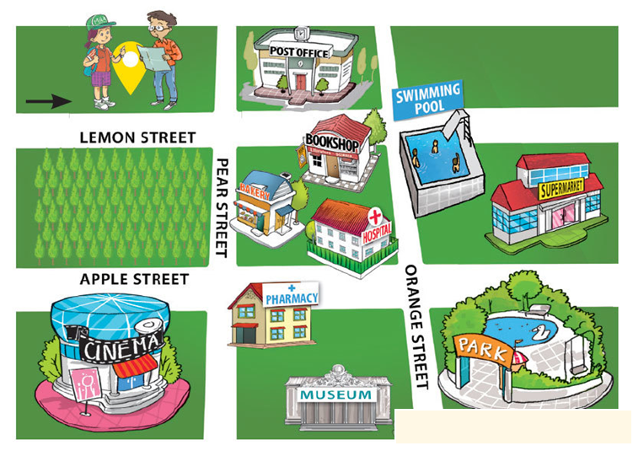
5. Write the directions.
1
A: Where's the park?
B: You are here, at Lemon Street. Go _____________________
________________________
________________________
___________________________.
straight ahead.
Turn right at Orange Street.
The park is on the corner of
Orange Street and Apple Street.

Slide 9
5. Write the directions.
2
A: Where's the pharmacy?
B: Go ______________________
___________________________
___________________________
___________________________.
straight ahead.
Turn right at Pear Street.
The pharmacy is on the corner of
Pear Street and Apple Street.

Slide 10
5. Write the directions.
2
A: Where's the pharmacy?
B: Go ______________________
___________________________
___________________________
___________________________.
straight ahead.
Turn right at Pear Street.
The pharmacy is opposite the
cinema.

Slide 11
6. Project

